Slide 1

Title: User Analytics in the Telecommunication Industry: TellCo Data Analysis for Growth Opportunities
Presented by: [Sapna Kharche]

Slide 2

Project Overview
The project aims to analyze customer data from TellCo, to identify growth opportunities and assess the company's acquisition potential. By exploring user behavior, engagement, experience, and satisfaction metrics, the project delivers actionable insights to drive profitability and strategic decisions.

Slide 3
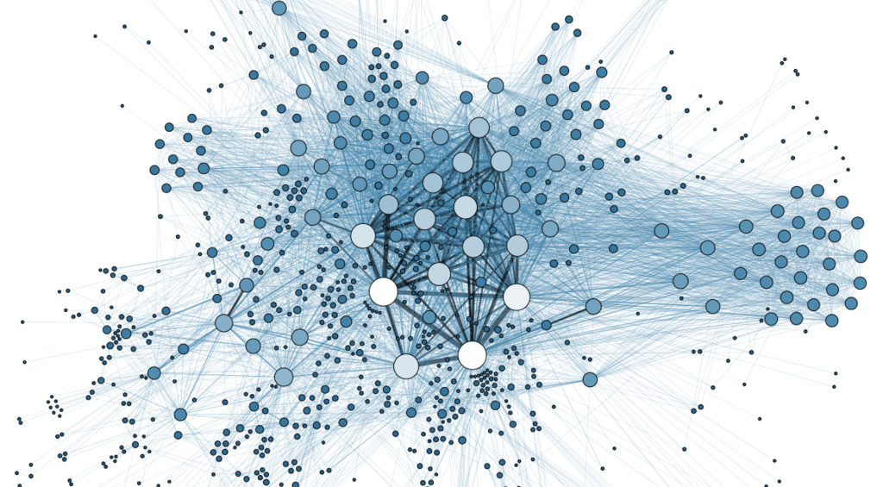
Problem Statement The objective is to evaluate whether TellCo is a valuable investment and to provide data-driven recommendations for enhancing profitability through targeted customer insights.
This Photo by Unknown Author is licensed under CC BY-SA

Slide 4

Solution
To address the problem, the project utilizes a systematic approach involving data cleaning, exploratory data analysis. By analysing xDR (data session detail records), the solution identifies key user behaviours and patterns, highlights top handsets and manufacturers, and segments users into engagement and experience clusters. The insights are then presented through an interactive dashboard.

Slide 5
Methodology The methodology is divided into four key phases:
User Overview Analysis: Identify top handsets, manufacturers, and user behaviors.
User Engagement Analysis: Evaluate session frequency, duration, and total data traffic to understand user engagement levels.
Experience Analytics: Assess network parameters such as TCP retransmission, RTT, and throughput to gauge user experience.
Satisfaction Analysis: Combine engagement and experience metrics to calculate a satisfaction score, helping to identify the most satisfied and dissatisfied customers

Slide 6
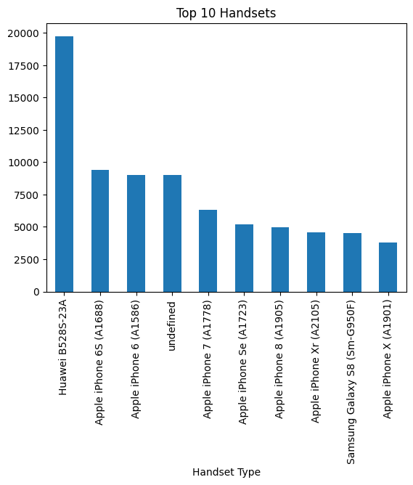
Key Features
The analysis revealed several key features of TellCo’s customer base:
Top 10 handsets used by customers, highlighting popular device preferences.

Slide 7
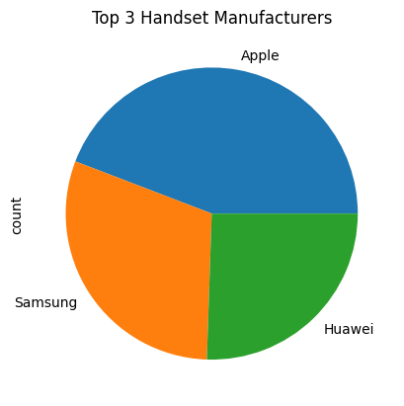
2. Top 3 handset manufacturers dominating the market.

Slide 8
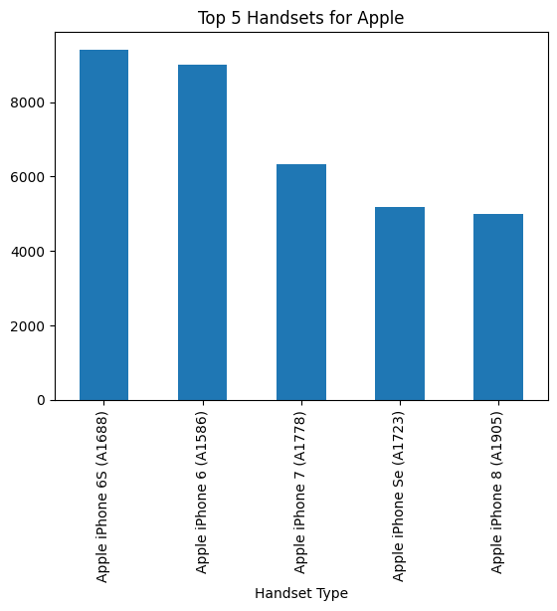
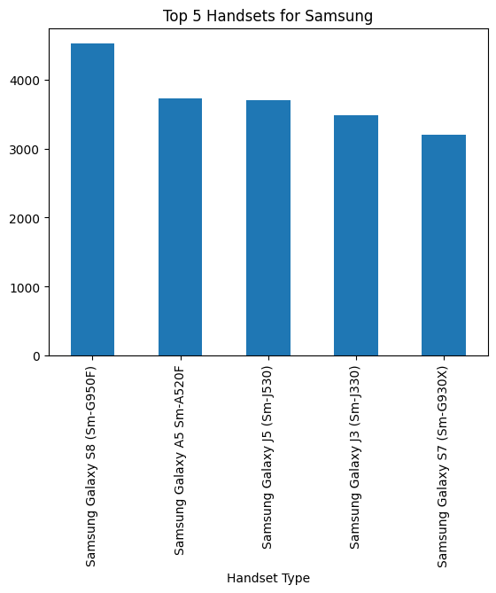
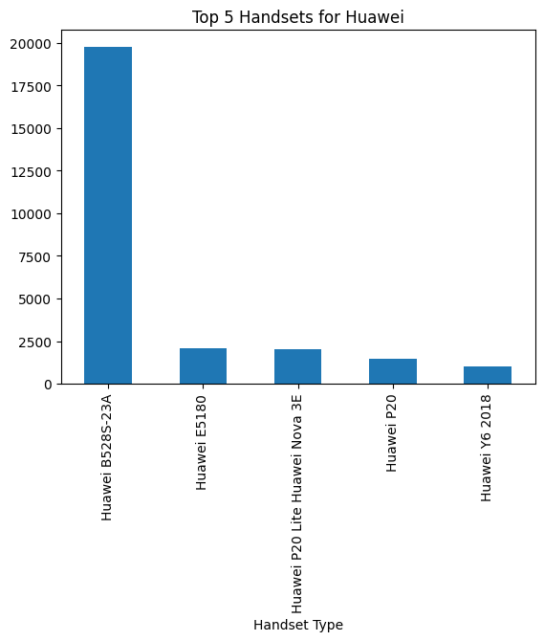
Detailed usage patterns for top handsets per manufacturer.
Insights into customer engagement across various applications like social media, gaming, and streaming, highlighting opportunities for targeted marketing.

Slide 9
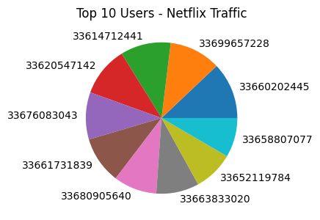
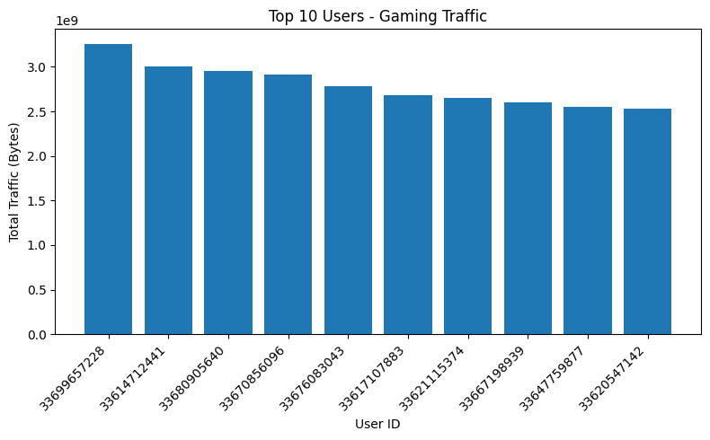
Results and Achievements
The analysis identified critical insights that can drive TellCo's growth:
High engagement among specific user segments who frequently use social media and streaming services.
Correlation between network performance metrics and user satisfaction, with specific recommendations for improvement.
Creation of an interactive dashboard that provides a clear visualization of user behaviors, engagement levels, and satisfaction scores.

Slide 10
Challenges Faced
Several challenges were encountered during the project:
Data quality issues, including missing values and outliers, were managed through imputation techniques.
Complexity in accurately clustering users due to variability in engagement and experience metrics.

Slide 11

Conclusion
The analysis confirms that TellCo has significant growth potential, particularly by targeting high-engagement user segments and optimizing network performance. Based on the current analysis, it is advisable for the investor to consider acquiring TellCo, focusing on enhancing customer experience based on identified user preferences.

Slide 12

Recommendations
Proceed with the acquisition of TellCo, Invest in network improvements to address performance issues identified in the user experience analysis.
Enhance marketing efforts targeting the most engaged users, particularly those with high data usage in social media and streaming services.

